Slide 1
Software Engineering
Related Jobs Analysis in New York City
Group 10
Houjian Yu, Kuan-Wei Chen, Xiaoyin Yang, Yu Shi

Slide 2
Content
Motivation and Goal
Methodology
Dataset Overview
Data Visualization
Conclusion

Slide 3
Motivation and Goal
Motivation:
Job seeking has been a very concerned topic for students.
Software-related positions have been increasing dramatically these years.
Pre-knowledge about relationship between job salary, required skills, education and location is very important when finding suitable jobs.
Goal:
Potentially help people in their job search
required skills
potential salary range
location

Slide 4
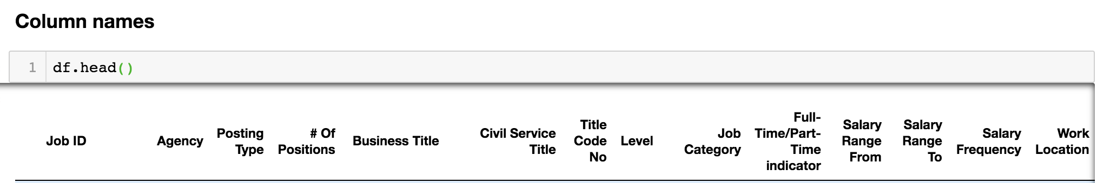
Methodology
U.S. Government’s open data https://www.data.gov/
Pre-process Data
Remove irrelevant columns

Slide 5
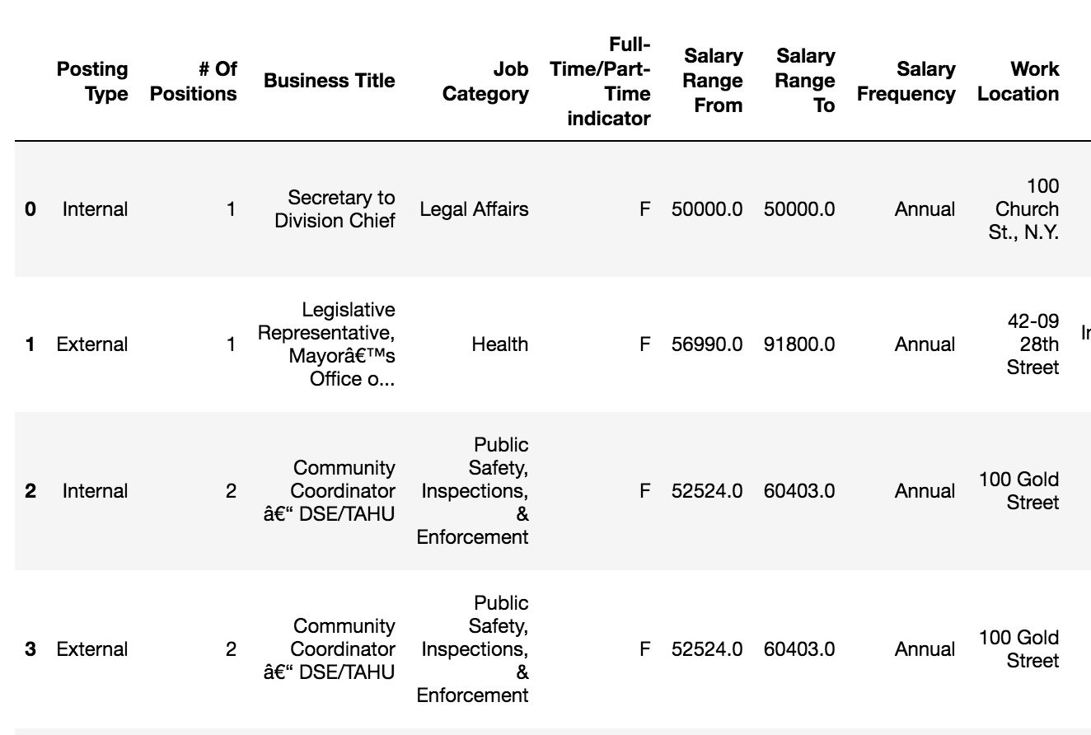
Methodology
U.S. Government’s open data https://www.data.gov/
Pre-process Data
Delete irrelevant columns
Keyword filter in ‘Job Category’ and ‘Business Title’
Keywords: Information, software, data, etc.
373 positions related to software jobs

Slide 6
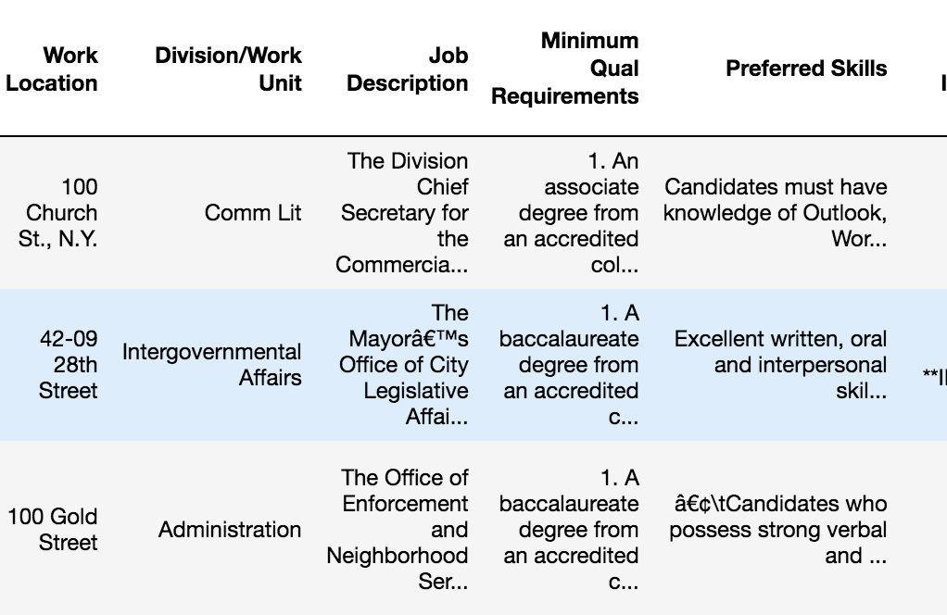
Methodology
Scrape keyword from ‘requirement’ and ‘skill’ columns
First, apply ‘split_count’ function in each column
Choose the frequent keyword in each column
Visualize data using matplotlib, Altair, Plotly, Geopy, Bokeh, etc.

Slide 7
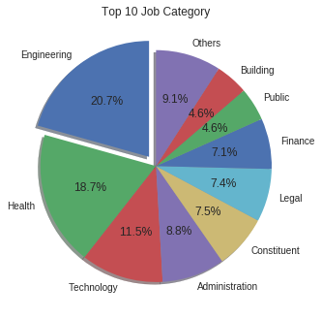
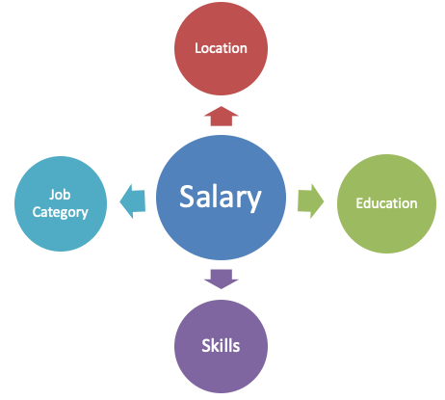
Dataset Overview
Time ranges from 2011 to 2019, with 3885 jobs in total in New York City.

Slide 8
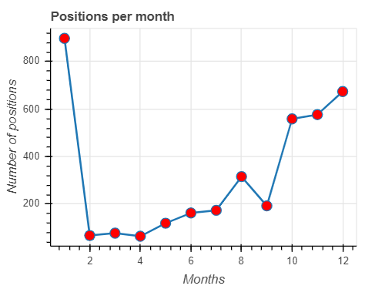
Position Available
Number of positions available in each month
Better shot for applicant from Oct. to Jan.

Slide 9
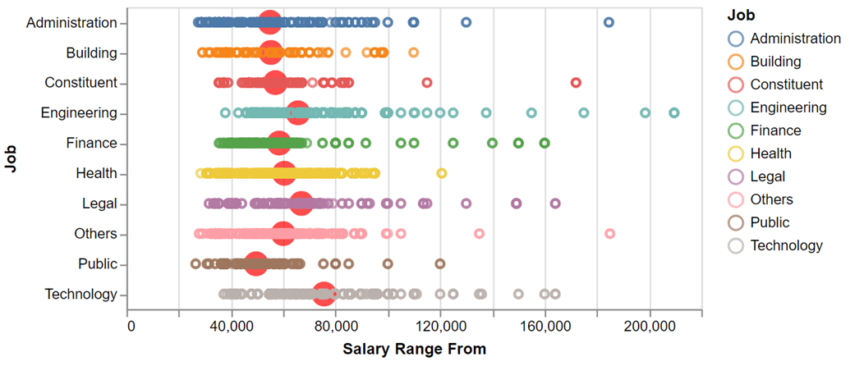
Job - Salary Distribution
* Annual Salary
Rank: Technology > Legal > Engineering > … > Public

Slide 10
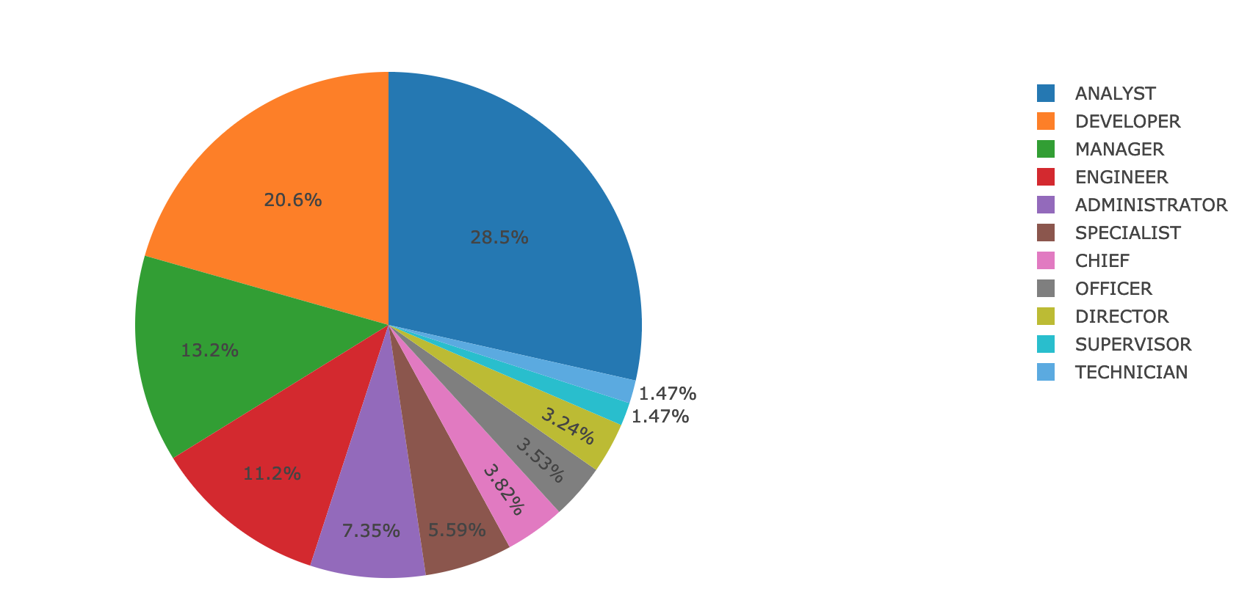
Software-Related Jobs
How to define software-related?
Using keyword search in ‘job category’, then search in ‘business title’.
After filtering, there’re 373 job positions relating to software.
Keywords distribution in software-related job title

Slide 11
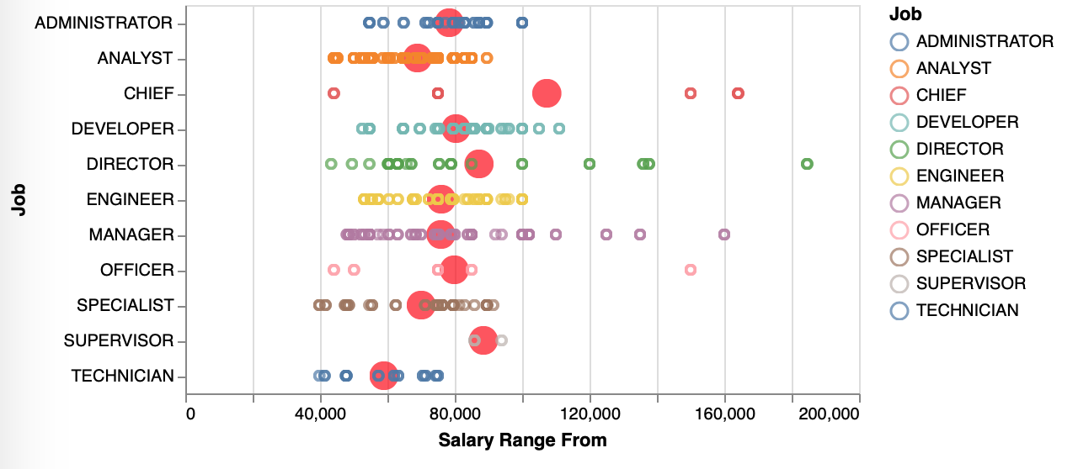
Software Job - Salary distribution
Rank: Chief > Supervisor > Director > Developer > … > Technician

Slide 12
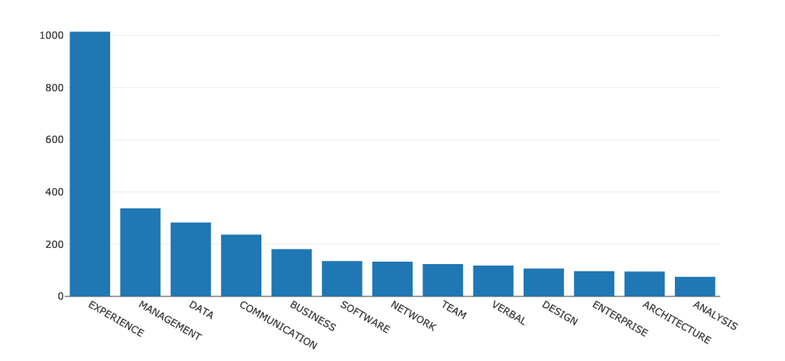
General Skill Overview
Keyword count in ‘Requirement’ column

Slide 13
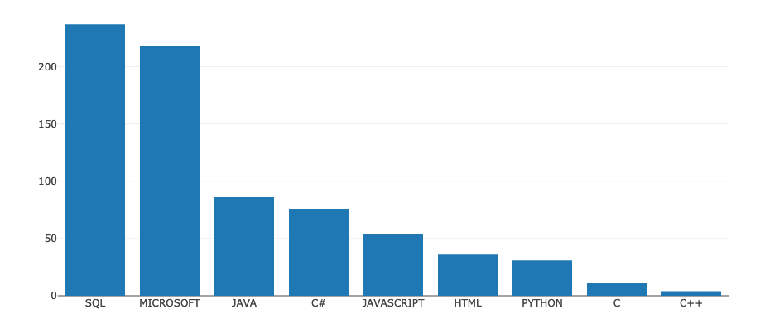
Software Skill Overview
Keyword count in ‘Prefered Skill’ column
A lot of job requirements do not mention the specific software language.

Slide 14
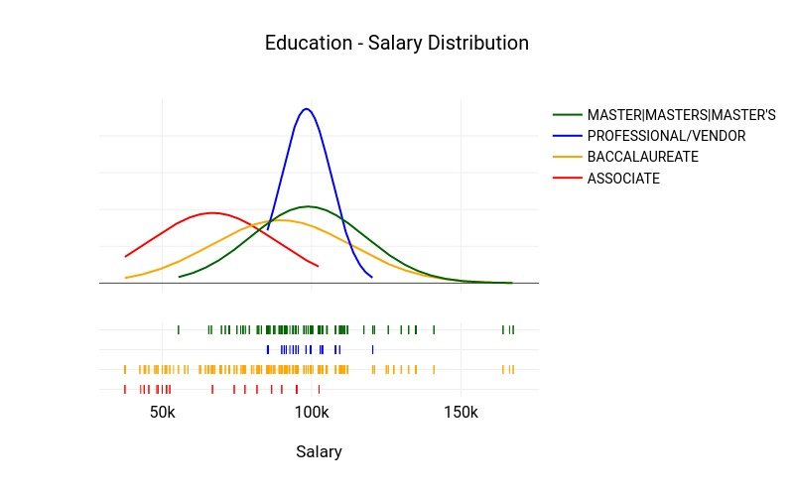
Education - Salary Distribution

Slide 15
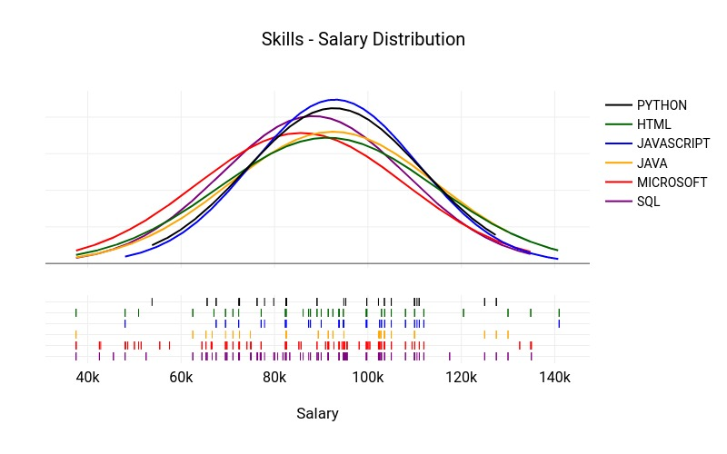
Skills - Salary Distribution

Slide 16
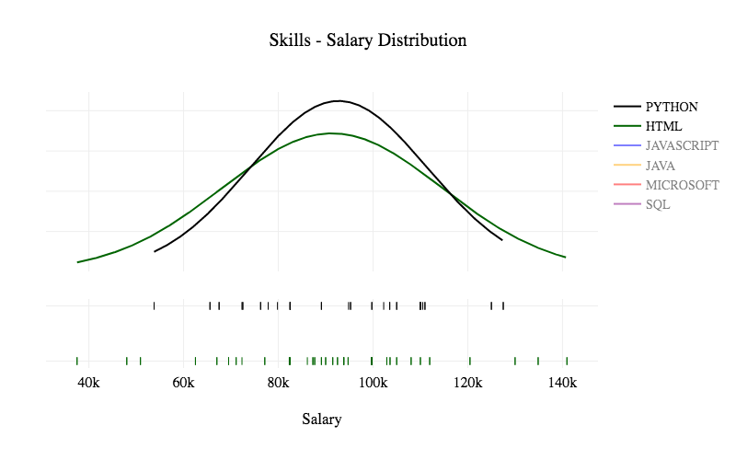
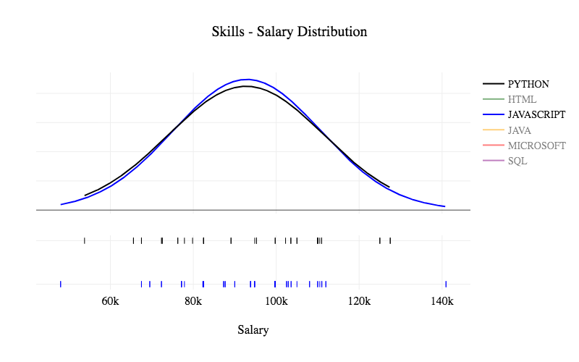

Slide 17
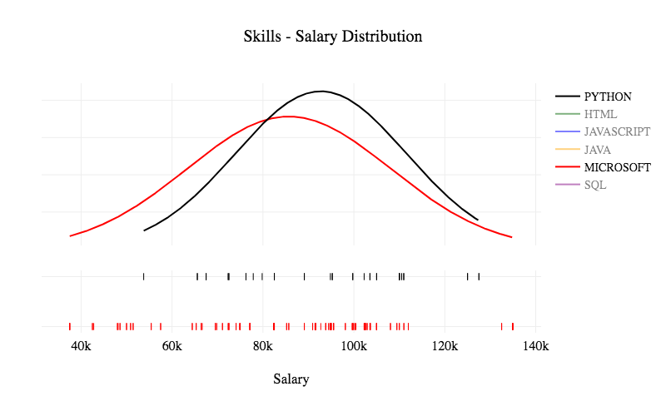
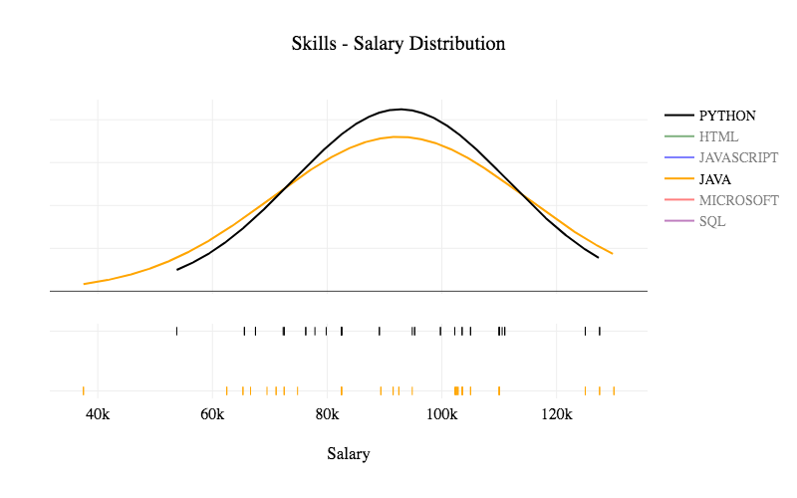
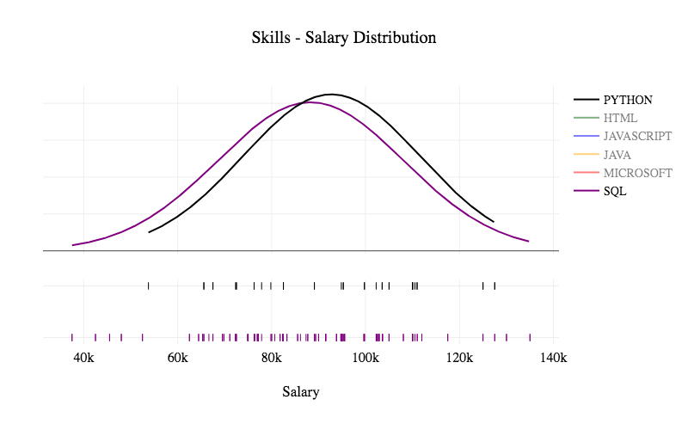

Slide 18
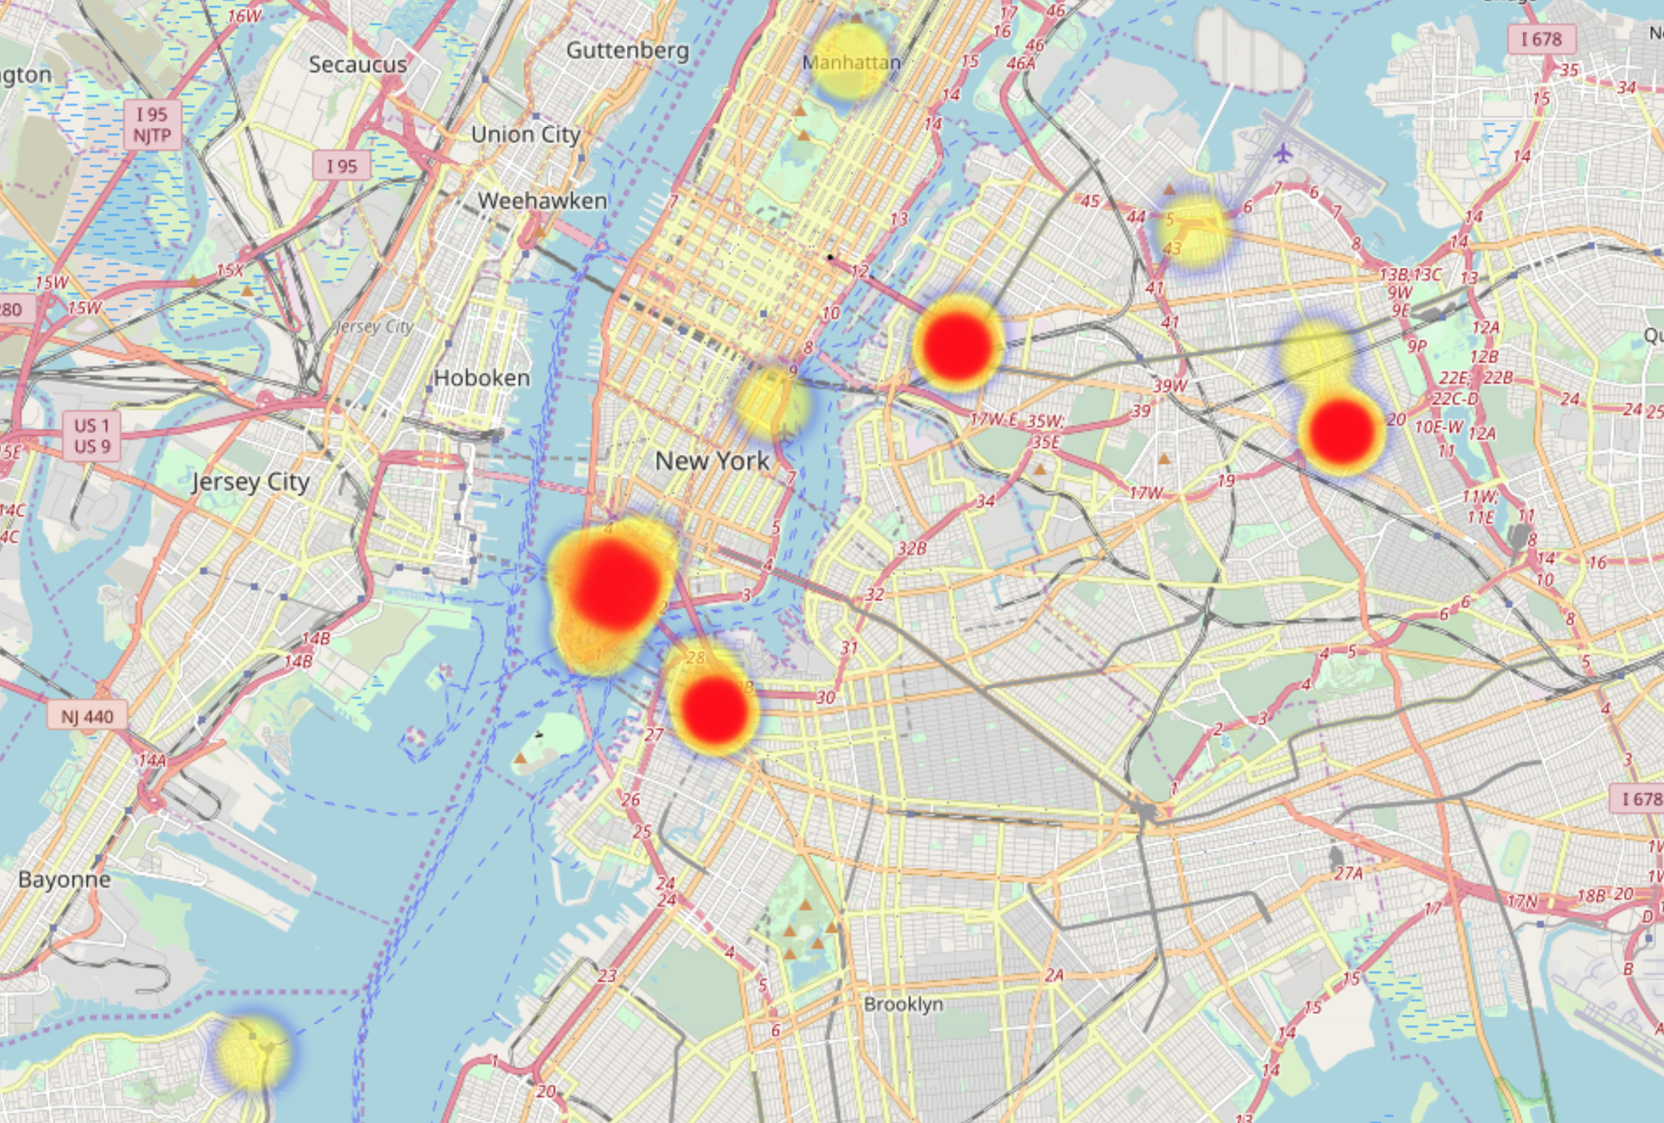
Job Location Distribution
Queen Area
Wall Street
Center Brooklyn
Red: High
Yellow: Median
Blue: Low

Slide 19
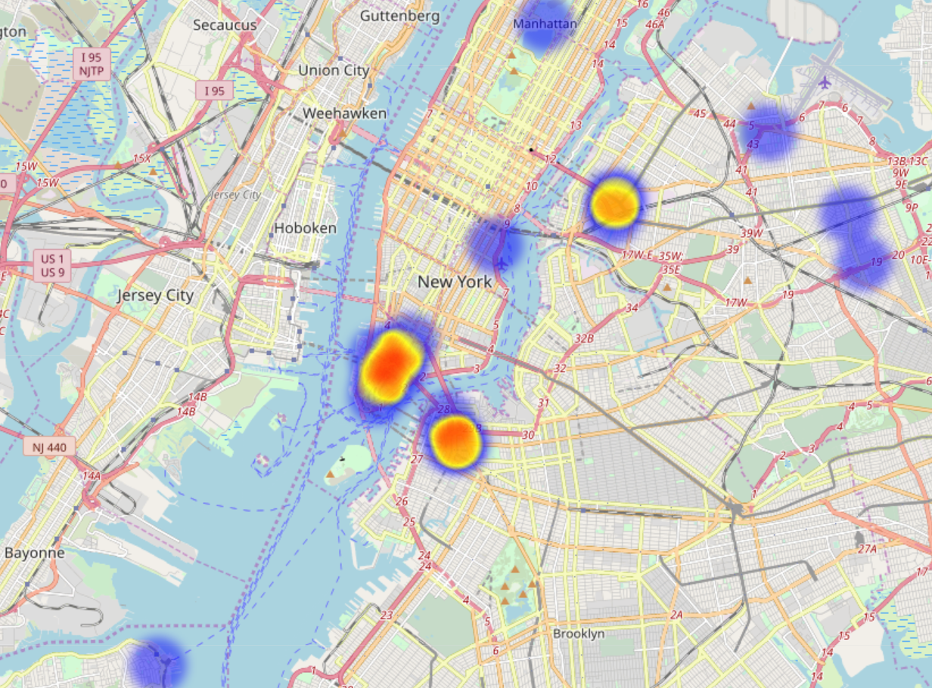
Salary Location Distribution
Queen Area
Wall Street
Center Brooklyn
Red: High
Yellow: Median
Blue: Low

Slide 20
Conclusion
Suggestion for seeking software-related jobs
Best time to apply for job is fall and winter.
For new graduate, software developer will have a high possibility of having a salary higher than average.
Master degree is not a must.
Learn more, earn more.
Try to have more work experience.
The area with more jobs always has higher salary.
Learn PYTHON !
Github: https://github.com/Xiaoyin96/ECE143

Slide 21
Thank you

